Slide 1
Computer Science 20
Looping

Slide 2
Repetition
Many Tasks are repetitive in nature. In real life, can you think of some examples?
Twist the lightbulb until it comes free
Do pushups until you are too tired to continue
Practice your free throws 100 times

Slide 3
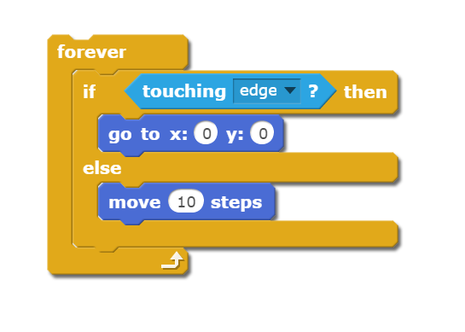
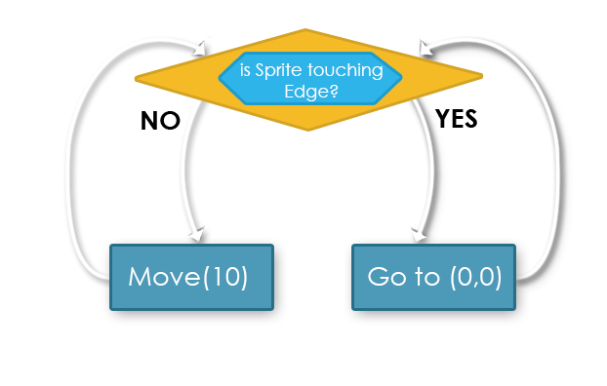
What we’ve seen
We’ve used forever loops many times. All the blocks inside the loop repeat continually.

Slide 4
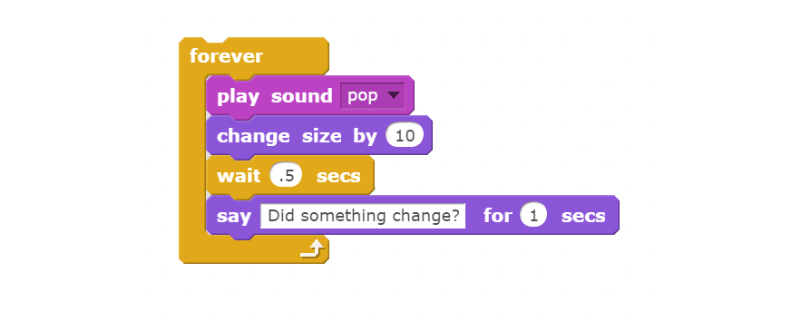
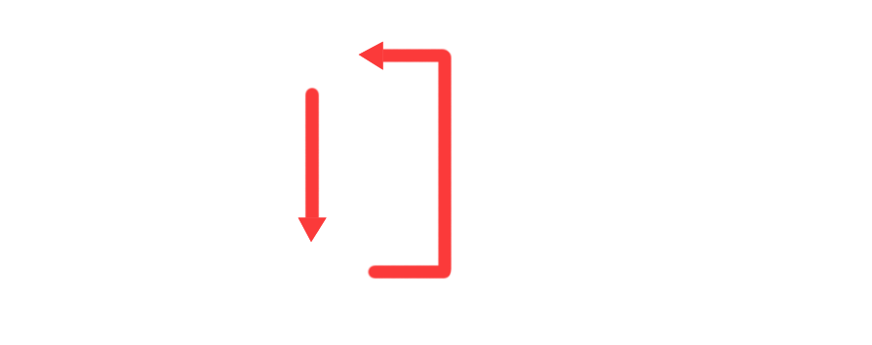
Loop and Loop Body
Two distinct components in the anatomy of a loop:
Loop – Structure that causes execution flow to repeat a number of times.
Loop Body – Code encapsulated within the loop; this is what is repeated.

Slide 5
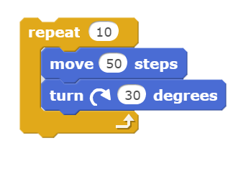
Other types of Loops
COUNTING LOOPS
Loop body is repeated a set number of times.

Slide 6
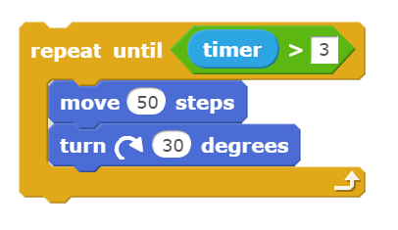
Other types of Loops
CONDITIONAL LOOPS
Loop body is repeated until the loop condition is satisfied.

Slide 7
Terminology
IF count <= 10: run loop body
IF timer <= 3: run loop body
Both of these loops are called Pretest Loops
Each iteration, the loop body only is executed after the loop test is satisfied.

Slide 8

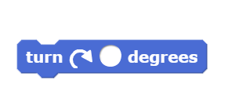
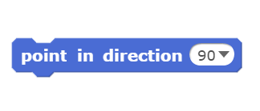
Turtle Graphics
Comes from early programming language – LOGO
Used to procedurally create images and teach programming.
To Simulate in Scratch, we will only be allowed 3 movement blocks:

Slide 9
Activity - Spirographs
A Spirograph is an image that is created by drawing a series of similar shapes that are offset by a constant angle.
Create a script that uses the PEN blocks, a loop, and one sprite to draw a square.
Create a repeat loop around our SQUARE script.
Repeat 36 times
Turn scratch 10 degrees after each SQUARE is drawn

Slide 10
Activity - Spirographs
A Spirograph is an image that is created by drawing a series of similar shapes that are offset by a constant angle.
Create a script that uses the PEN blocks, a loop, and one sprite to draw a circle.
Create a repeat loop around our Circle script.
Repeat 18 times
Turn scratch 20 degrees after each Circle is drawn
Next: can you combine the Circles and Squares to make a Spirograph where those shapes alternate?

Slide 11
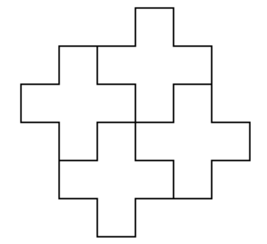
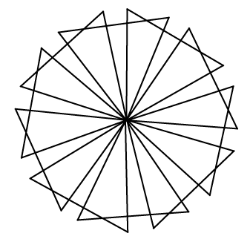
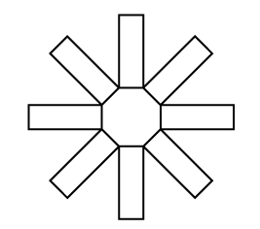
On Your Own
Starting with different PRIMITIVE shapes, we can create complex spirographs. Try the following:

